Slide 1

Predicting Flight delays
Time Series presentation
Lina Austrevicius
Adesh Ghadge
Anthony Moliterno

Slide 2

Agenda
Business Problem
Data Exploration
Data Cleanup
Data Preparation
Proposed Models
Model Evaluation
Proposed Solution
Future Improvements

Slide 3
Business Problem
According to the US Bureau of Transportation Statistics more than 1 million flights were delayed between June 2015 and June 2016.
About 64 million minutes were lost due to the flight delays.
Three main reasons for flight delays have been identified by the US Bureau of Transportation Statistics:
50% of flights are delayed due to various circumstances that were within airline’s control, such as aircraft maintenance, crew scheduling, refueling, etc.
30% of the delays are weather related.
15% of the delays are caused by broad issues within aviation network, such as airport operations, heavy traffic volume, or problems with air traffic control.
GOAL
Our goal is to predict how early or late a flight will take off from O’Hare airport compared to the scheduled time.
Notes:
https://www.businessinsider.com/why-your-flight-is-delayed-2016-8

Slide 4
Data Exploration
2015 data used for training the models and is obtained from https://www.transtats.bts.gov, includes 5,215,133 rows.
2016 data used for testing the models and is obtained from https://www.transtats.bts.gov, includes 5,061,671 rows.
Weather data obtained using O’Hare’s zip code from https://www.ncdc.noaa.gov/cdo-web/datasets.

Slide 5
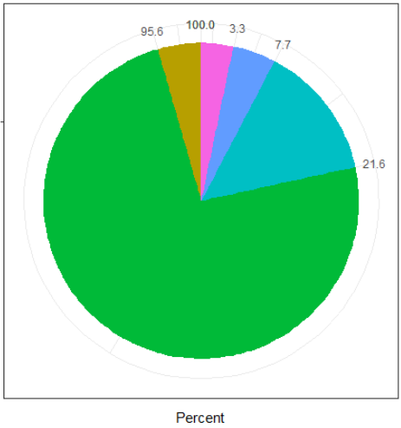
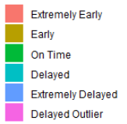
Data Exploration
4.44%
18.30%
Notes:
Do a pie chart for this

Slide 6
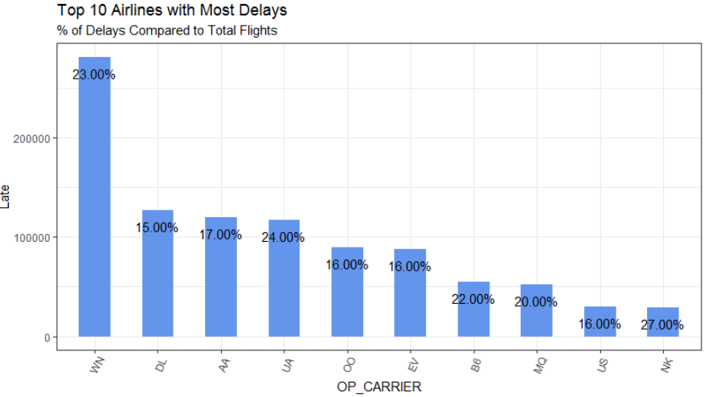
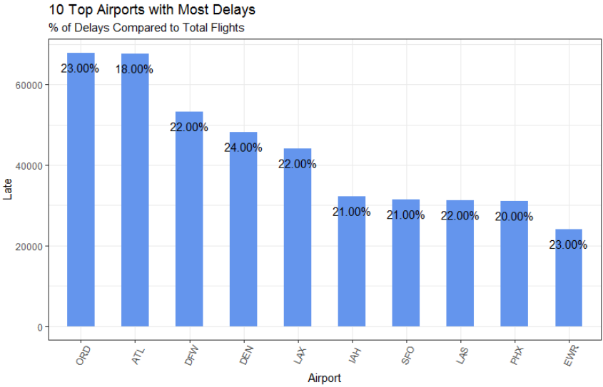
Data Exploration

Slide 7
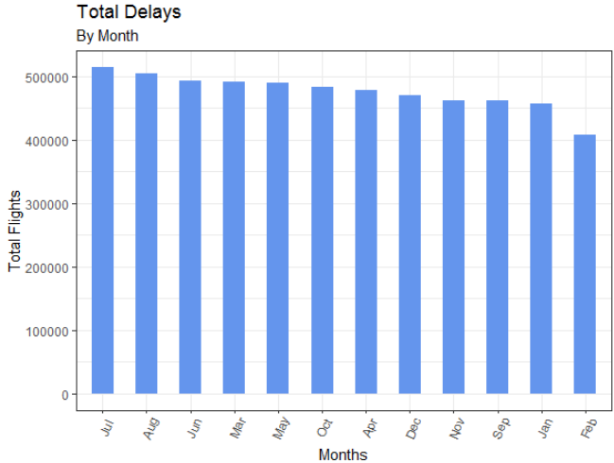
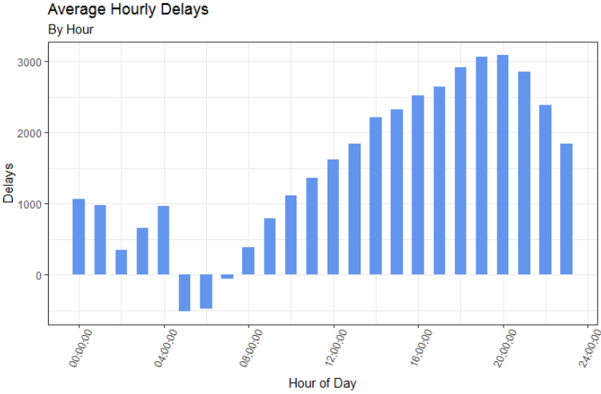
Data Exploration
Popular vacation time
10am – 10pm
Notes:
Do an hourly chart for 24 hours similar to this

Slide 8
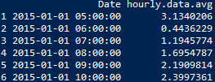
Data cleanup and preparation
Prepared an average delay per hour, taking a difference between actual and planned departure times.
Based on data exploration, chose ORD-origin flights to model flight delays.
Based on data exploration, removed hours of low flight activity for further modeling (similar to stock market closure).
Greater than 90 minute delays were considered outliers. Removed these extreme points from further modeling.
Imputed missing values.
Cleaned weather data to make it consistent with the flight data. Weather data was used to model weather impact on flight delays.

Slide 9
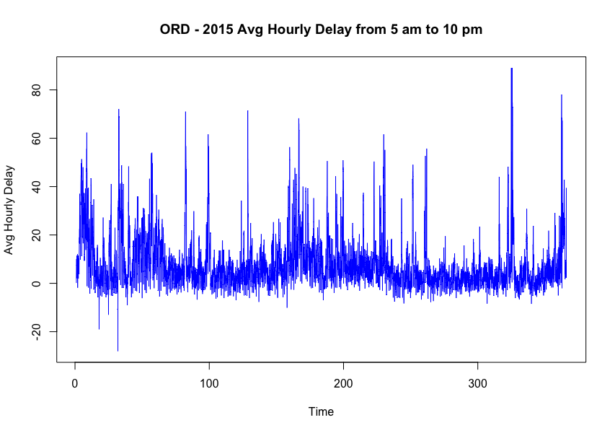
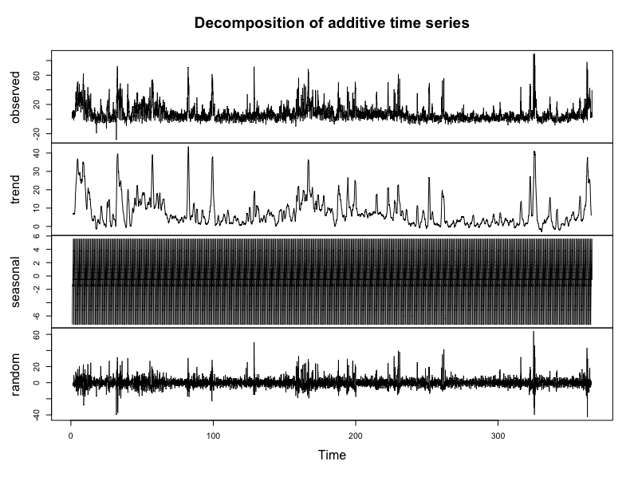
Time Series Review

Slide 10
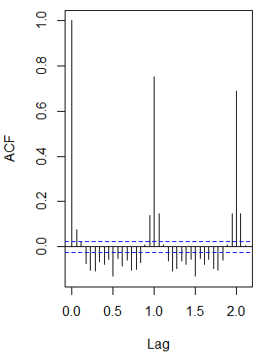
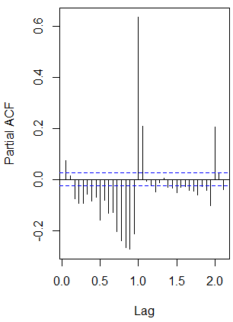
Arima model
Examining Time series data exhibited clear auto correlation, which is suitable for ARIMA model.
Checked ACF/PACF charts for AR() and MA() estimation.
Set peak seasonality point as our frequency setting (18th hour, or full day).
Conflicting stationarity tests – So we tried models with and without differencing.

Slide 11
Weather data review– miniscule use
Viewed correlation matrix for intuition. Generally low correlation to the hourly departure data (i.e. <0.10).
Examined a simple lm(DepartureDelay~Weather_Variables).
Used regsubsets() and step() functions to determine optimal variable choice.
Weak R^2 at 0.06.

Slide 12
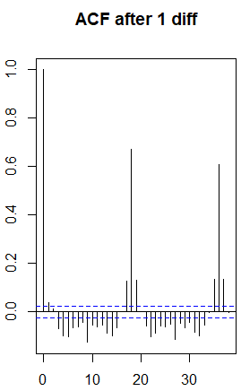
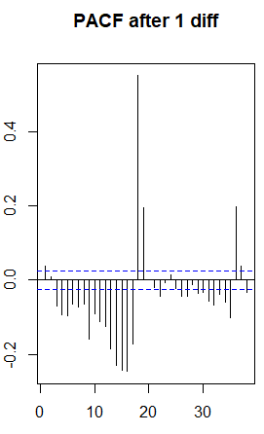
Arima model – PDQ estimation
I(1)
AR(p)(P)
MA(q)(Q)

Slide 13
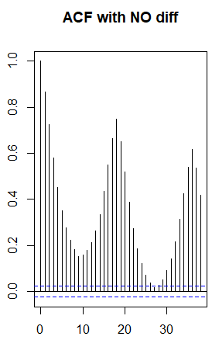
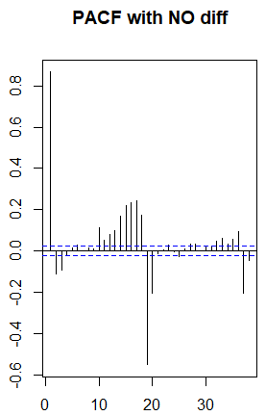
Arima model – PDQ estimation
I(0)
AR(p)(P)
MA(q)(Q)

Slide 14
Arima Model candidates
Arima, Sarima, Linear Regression w/Arima on errors.
ARIMA(2,0,0) – AIC 23777.
Without differencing.
SARIMA(1,1,2)(1,0,1) – AIC 23087.
Differencing, seasonality.
LM w/ARIMA(1,1,1)(1,0,1) – AIC 23257.
Hand-picked estimates.
LM w/ARIMA(1,0,26)(1,0,0) – AIC 22857.
Hand-picked estimates.
Auto LMw/ARIMA(3,1,2)– AIC 23742.
Auto estimates.

Slide 15
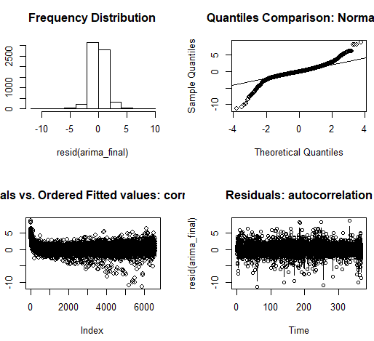
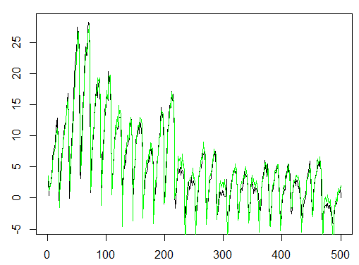
Model results & Analysis of Errors LM w/ARIMA(1,0,26)(1,0,0)
Model is fairly good but poor for outliers.

Slide 16
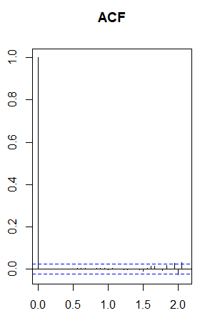
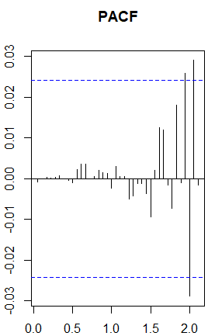
Model results & Analysis of Errors LM w/ARIMA(1,0,26)(1,0,0)
ADF and KPSS tests indicated stationarity in errors.
ACF and PACF indicated weakness in eliminating seasonal autocorrelation – R had issues calculating seasonality factor of 2.
Ljung-Box test indicated residuals were independent at 0.9866.

Slide 17
Testing results LM w/ARIMA(1,0,26)(1,0,0)
Testing model against 2016 flight + weather data.
Compare results against a simple “predict-using-last-value” model.
Notes:
Still not buying that we need this slide

Slide 18
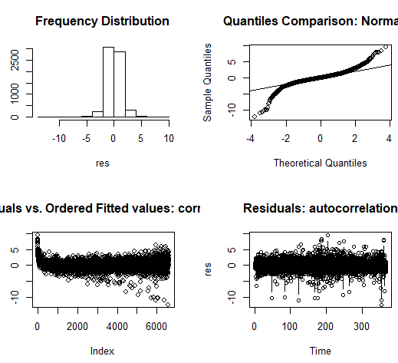
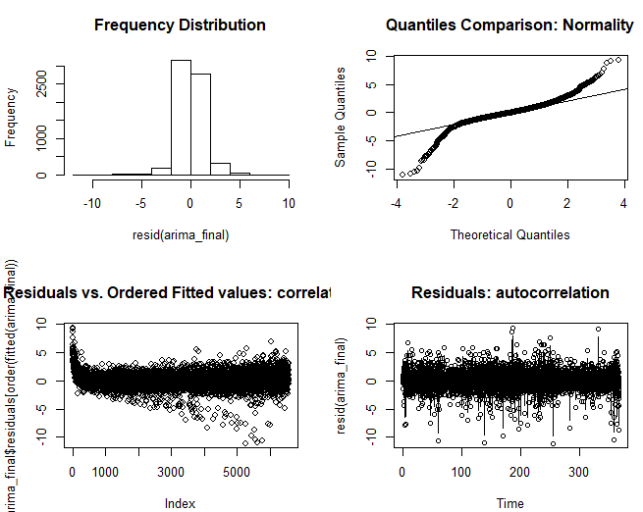
Testing results LM w/ARIMA(1,0,26)(1,0,0)

Slide 19
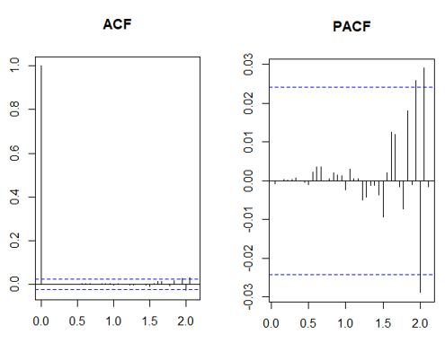
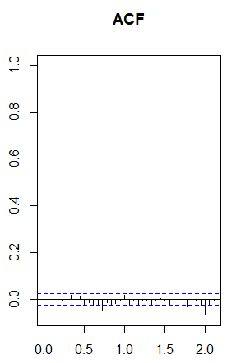
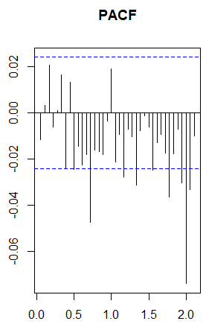
Testing results LM w/ARIMA(1,0,26)(1,0,0)
ACF/PACF of residuals held up reasonably fair.

Slide 20
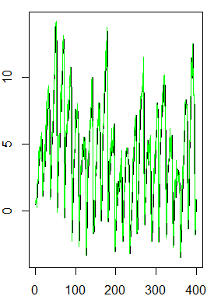
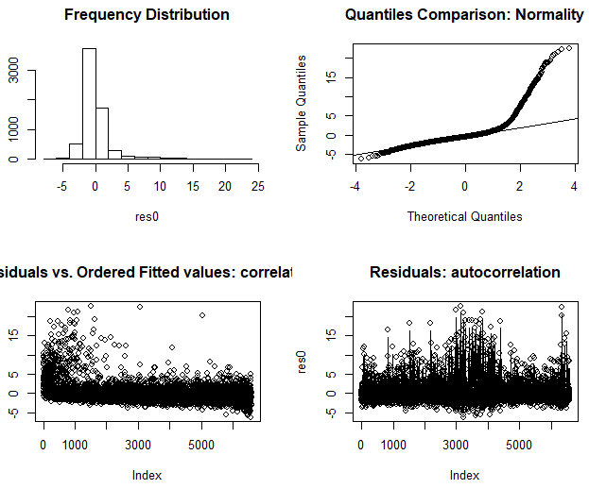
Result comparison – last-value approach LM w/ARIMA(1,0,26)(1,0,0)

Slide 21

Final results
LM w/ARIMA(1,0,26)(1,0,0)
The model’s test results was competitive but did not significantly beat the simple Last-Value approach.
The model’s point estimates were more vulnerable to the data’s high/sudden
However, given the model’s better distribution in errors, it makes for much better use for confidence intervals.
volatility.

Slide 22
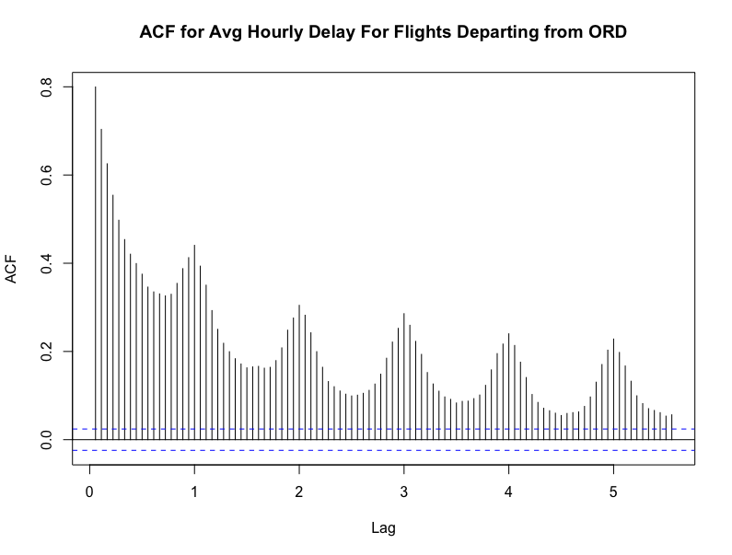
ARFIMA model
ACF plot decays very slowly – long memory.
Hurst exponent: 0.528

Slide 23
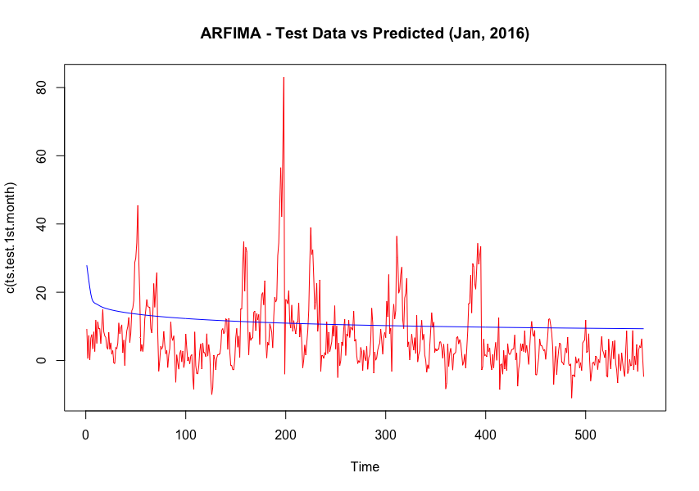
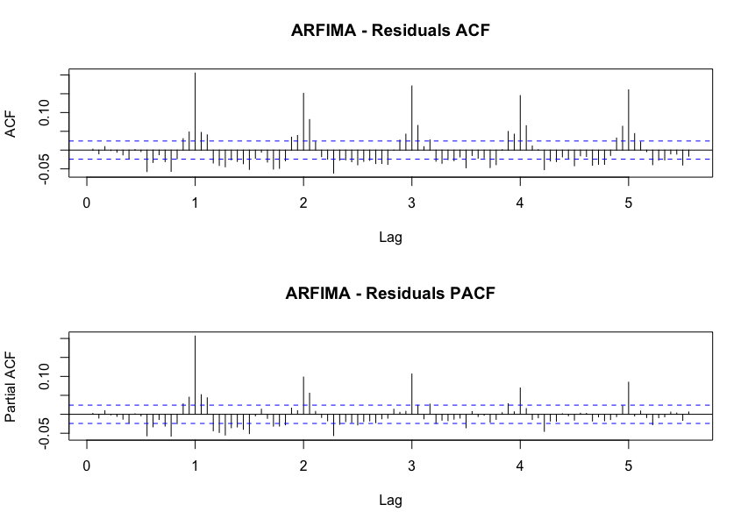
ARFIMA model - results
Coefficients:
Box-Ljung test for model residuals
p-value = 0.001976

Slide 24
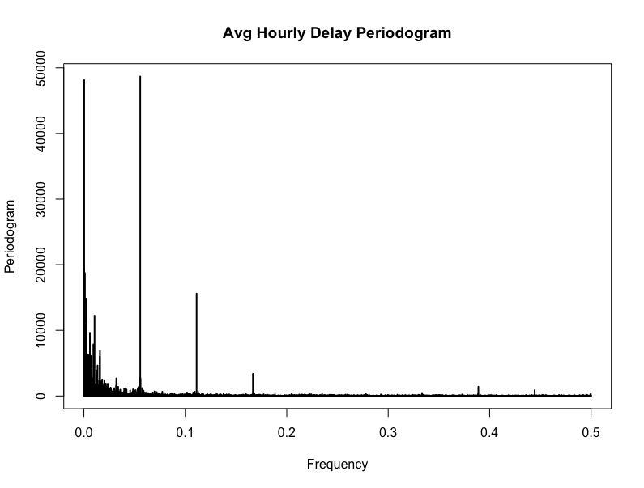
Frequency Domain Representation

Slide 25
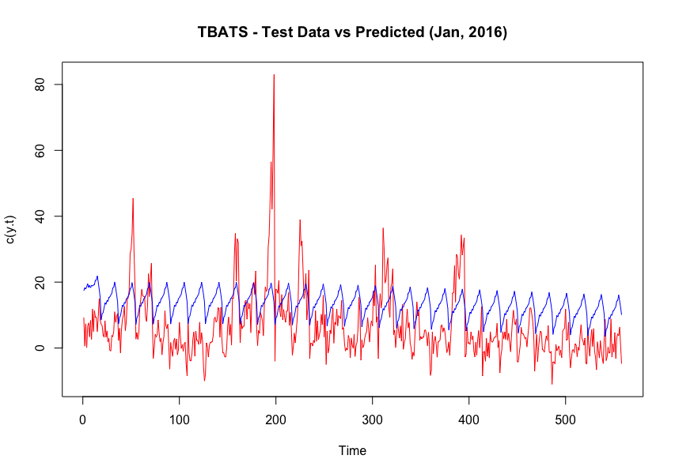
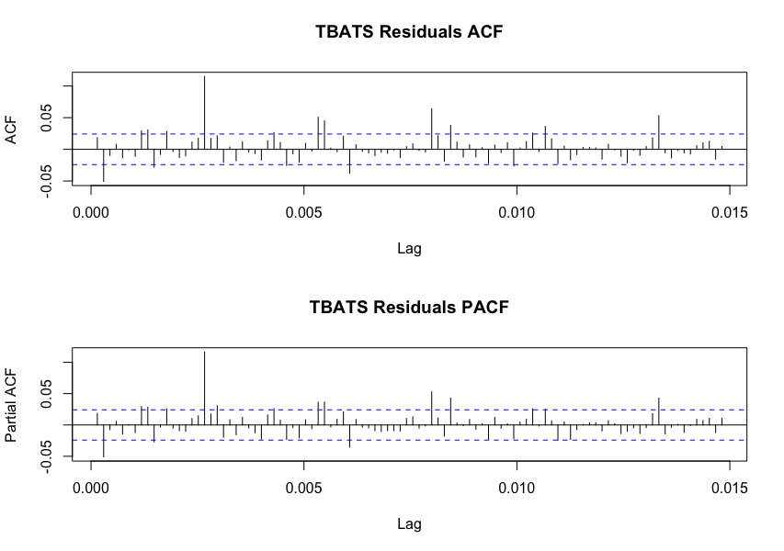
TBATS Model
TBATS(1, {1,1}, -, {<18,8>, <3375,3>, <6750,1>})
Box-Cox transformation of 1
ARMA(1,1) errors No Box-Cox damping parameter is used
Seasonality modeled using 8 Fourier harmonics with period m=18
Seasonality modeled using 3 Fourier harmonics with period m=3375
Seasonality modeled using 1 Fourier harmonics with period m=6750

Slide 26
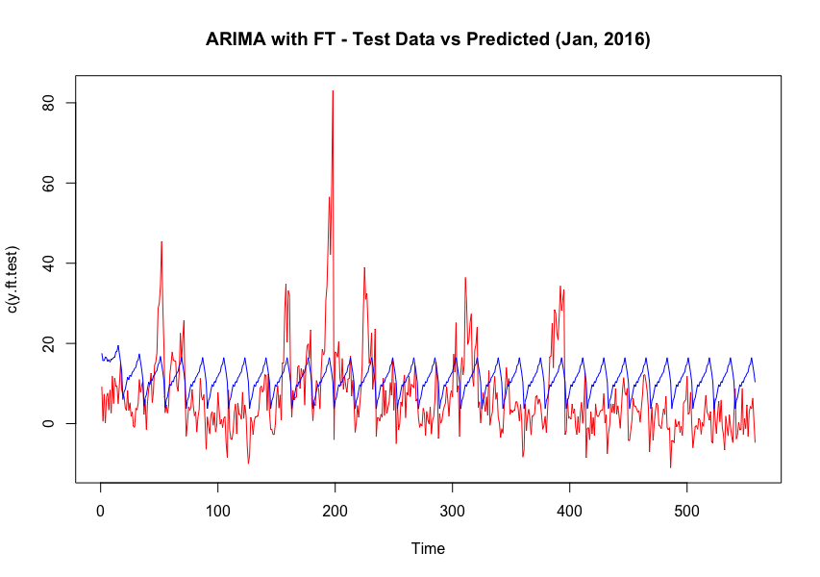
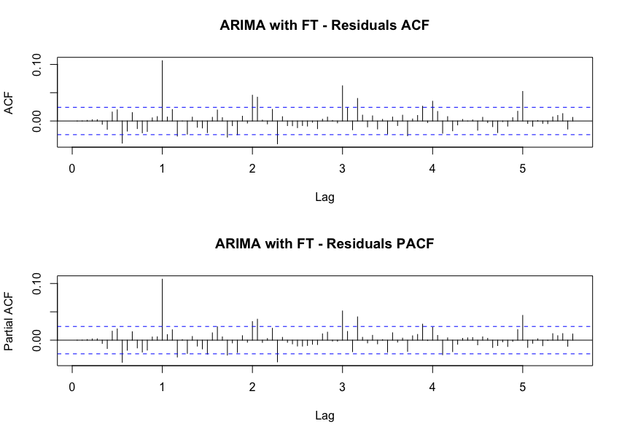
Arima model Fourier Terms
Arima(y.ft, order=c(5,1,4), xreg=fourier(y.ft, K=c(8)))
Seasonal pattern is modelled using Fourier terms.
The advantages of this approach are:
It allows any length seasonality.
For data with more than one seasonal period, you can include Fourier terms of different frequencies.
The short-term dynamics are easily handled with a simple ARMA error.

Slide 27
Model comparison & EVALUATION
Based on sMAPE the ARIMA with Linear Regressors is the best performer.
External factors are affecting the delays.
Possible improvements in model by incorporating other factors that are affecting delays.

Slide 28
FUTURE WORK
Add data from previous years to improve accuracy.
Analyze data based on airlines.
Add data from other sources (weather, airline fleet age).
Study impact of flight destination on delays.

